Slide 1
Web Frameworks Lecture 5
Node
Introduction to Node
Event Loop
NPM
Core Modules

Slide 2
Node
Node is an open-source cross platform JavaScript runtime environment.
Runs on V8 Engine (Chrome JS Core)
Can be used to run / write any kind of program not just web apps
Single Process (not multi-threaded)
Non-Blocking uses Event Loop
Unique advantage: Everyone already knows JavaScript
Many many libraries and frameworks:
Express JS – Web Server Framework
Meteor: Full Stack Framework
Next JS: TypeScript based hybrid

Slide 3
Node
13 years old – Created in 2009
Node is not exclusive to the browser
No Document or Window available
Node is a RUNTIME environment

Slide 4
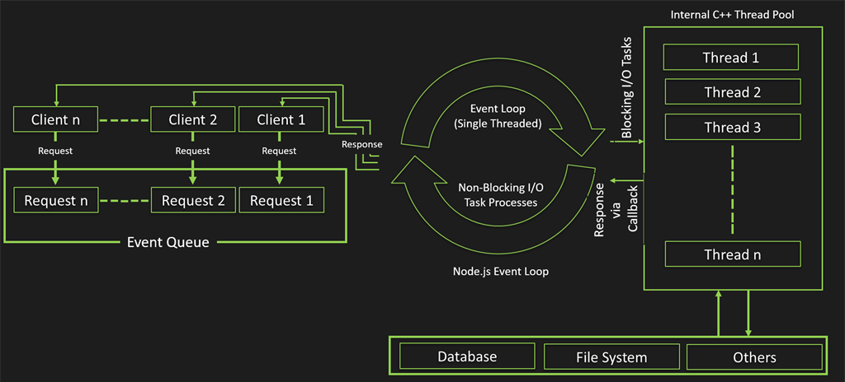
Node Event Loop

Slide 5
Node
Installing Node
https://nodejs.org/en/download/
Verify Installation
node –v
Node and TypeScript
Node is not written natively to support TypeScript (see Deno)
But you can use TypeScript just fine because TypeScript output is JavaScript
Dev Dependencies npm i @types/node
NPM (Node Package Manager)
Standard Package manager for Node
Manages the downloads of dependencies on a node project
npm i <package name>
Npm root –g will show you where global packages are installed

Slide 6
Node
npm init
Generates a package.json file
This file tells node how to execute your project it also contains dependency versions, and execution scripts
Node Core Modules
Fs Module
Path Module
Os Module
Events Module
Http Module

Slide 7
Node
FS Module
File Manipulation Library https://nodejs.dev/en/learn/the-nodejs-fs-module/
Path Module
Library for working with Paths and Directories https://nodejs.dev/en/learn/the-nodejs-path-module/
OS Module
Library to retrieve information on the Operating System https://nodejs.dev/en/learn/the-nodejs-os-module/
Http Module
Core to Node networking and communication https://nodejs.dev/en/learn/the-nodejs-http-module/

